Slide 1
Efficient Tourist Route Planning in Bangladesh: A Time-Conscious Tourist Places Recommendation System
Supervised By
- Md Mostofa Kamal Rasel

Slide 2

Group Members
Fima Faria Lisa
- 2020-1-60-026
Noshin Tasnim Khan
- 2020-1-60-221
Farhana Jaman
- 2020-1-60-006
Ayesha Chowdhury
- 2020-1-60-003

Slide 3

Introduction
Why is a Tourist Recommendation System needed?
Why not use Existing tourist Recommendation Systems?

Slide 4

Motivation
The existing recommendation system overlooked the Time constraints of Travellers.
Lack of Tourist Recommendation system in Bangladesh where tourist places in every upazila can be found.

Slide 5

Problem Statements
But the dataset doesn’t contain information about travel time between two tourist places. How we will measure time to fulfill our goal to meet time frames when we don’t know about travel time?

Slide 6

Solution
Use Google Map
Use latitude and longitude to measure the distance between two tourist places and estimate time.

Slide 7

Objective
Recommend tourist places and plan routes considering the time frame where starting time, and departure time will be given to do recommendations.
Develop a tourist recommendation system where tourist places in every upazila of Bangladesh can be found.

Slide 8

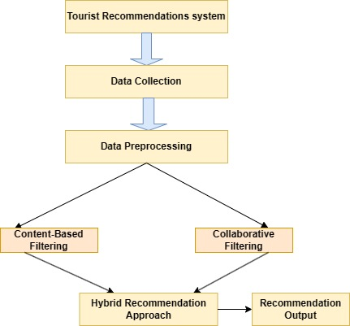
Proposed Work

Slide 9
Data Collection
Data Collection Steps:
Data Gathering from Google Places API
Data Processing
Data Transformation
Database Integration
Quality Assurance

Slide 10
Data Collection
Database Collection Challenges:
Paper and Website
Google Maps API Key Issues
Wikipedia Data Retrieval Problems
MySQL Configuration Adjustment
Importing dataset with coding issues

Slide 11
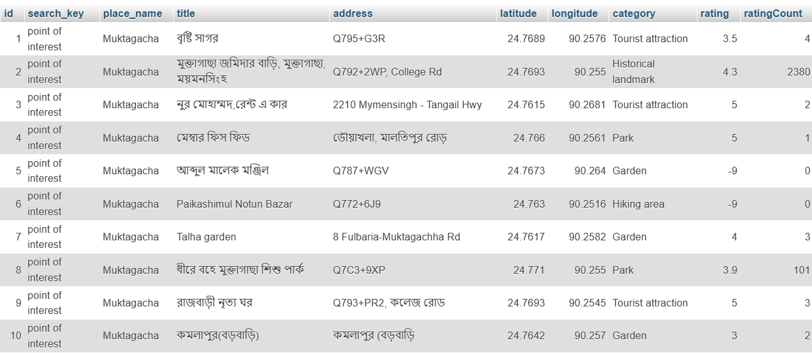
Database

Slide 12

Expected Result
Deliver a tourist Recommendation System that recommends tourist places within a time frame given by the traveller.
Plan the route from the present location to all the tourist destinations that can be covered within that time frame.

Slide 13


